Slide 1
Lab 5: Color Sensor for Visually Impaired Patients
By Socheath Sok

Slide 2
Overview
Background Information
Sense of Sight
Color Blindness
RGB Sensor
Schematics
Motor
16x2 LCD
RGB sensor TCS34725
Code
Limitations and Improvements
References

Slide 3
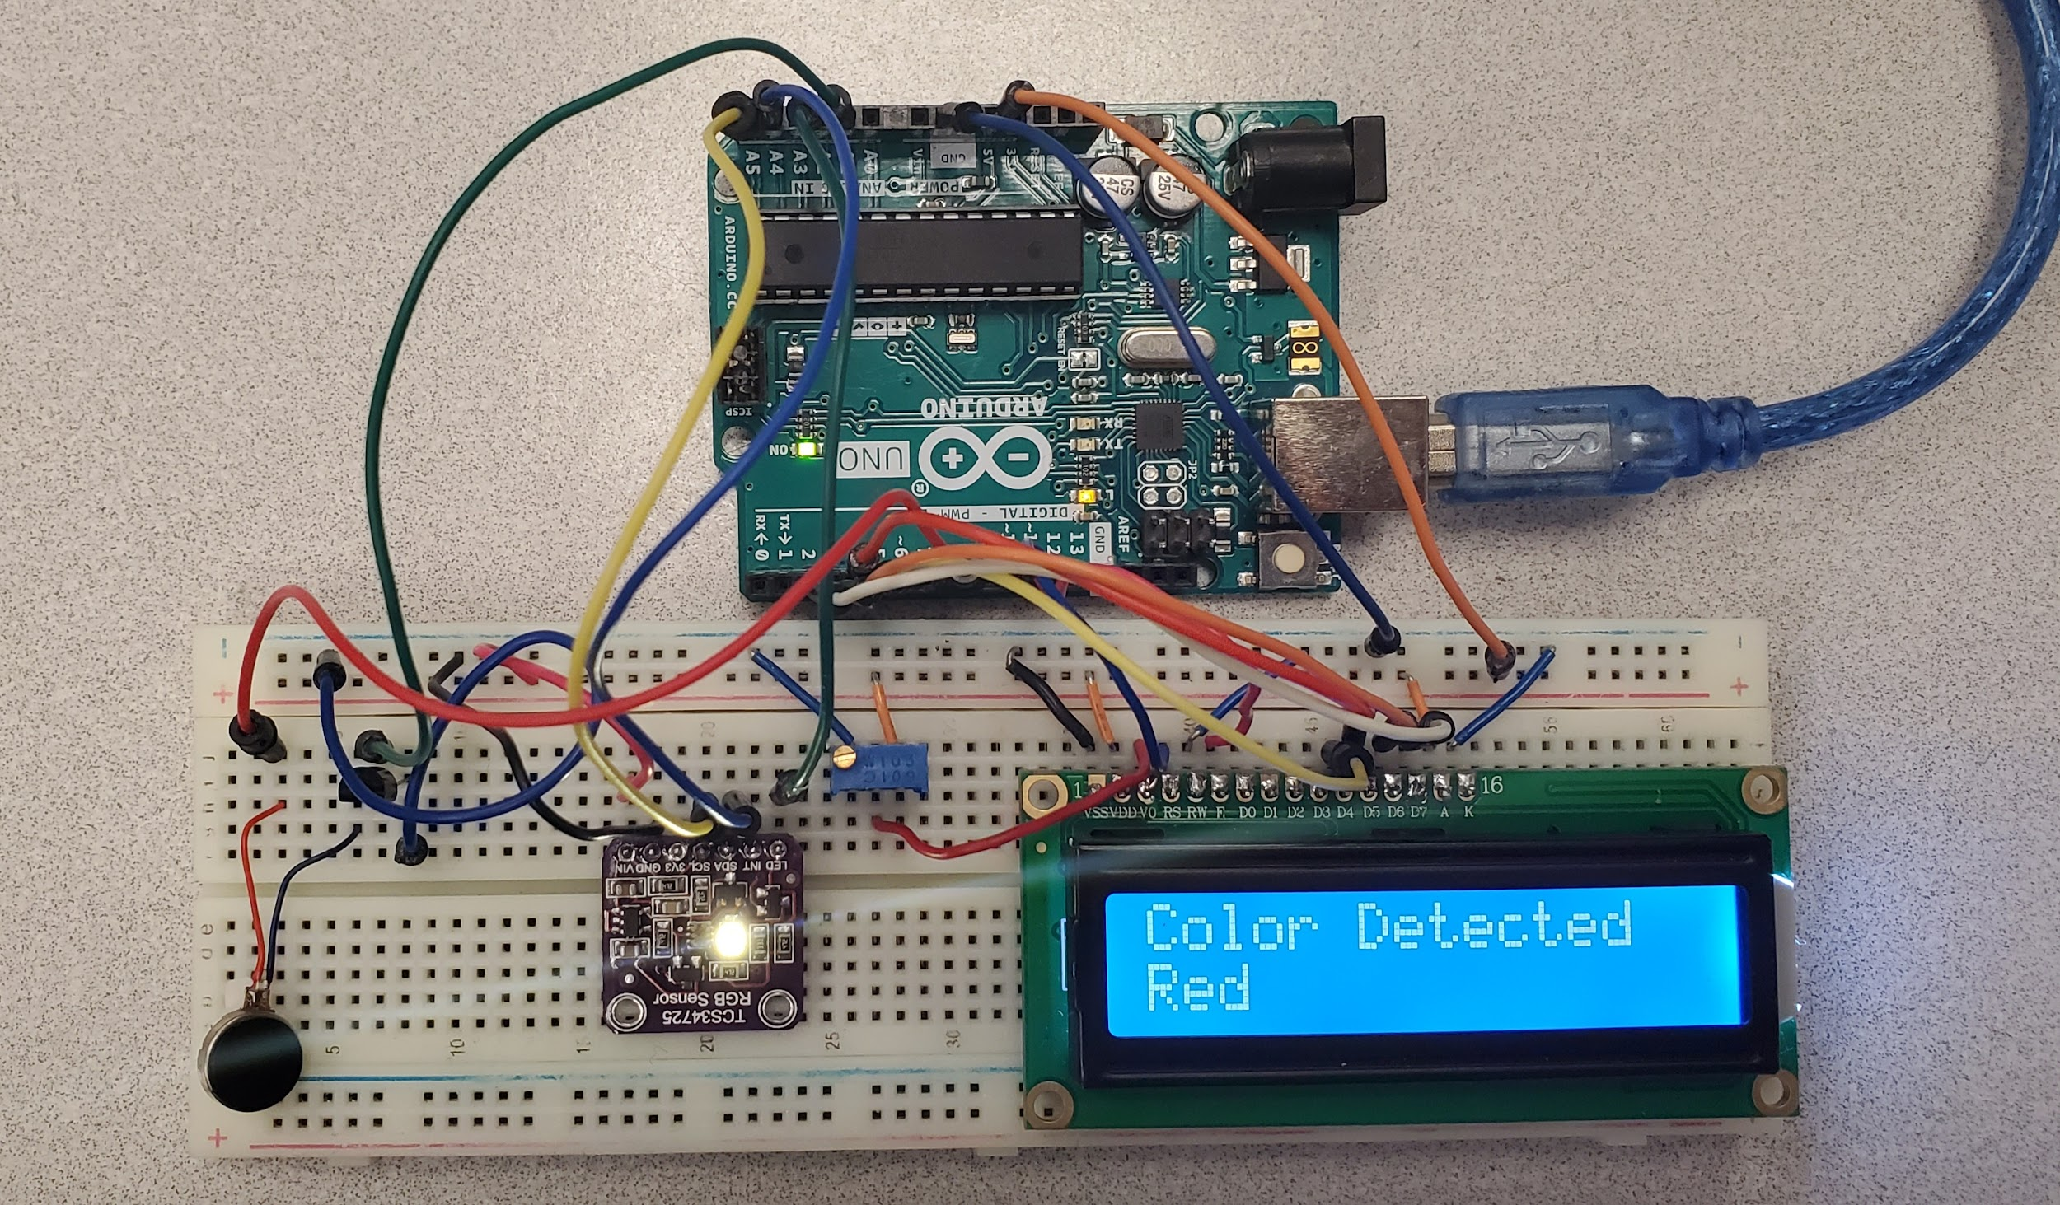

Slide 4
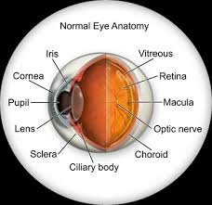
Sense of Sight
Eyes are the body's most highly developed sensory organs
Use to gather most of the information about our surroundings
25% of the cerebral cortex is dedicated to visual sensing
Eyes consist of a black spot called the pupil and a colored ring called the iris
Iris: constrict or widen the pupil
let an appropriate amount of light in.
Cornea: layer located in front
Help focus the incoming light onto the retina.
Retina collect and interpret raw information such as shapes and colors.
contains many photoreceptors such rods and cones
Overall, as much as ⅔ of the brain, directly and indirectly, involved with vision
[1]
Notes:
central nervous system. It plays a key role in attention, perception, awareness, thought, memory, language, and consciousness
Rods detect only light and dark and are very sensitive to low light levels. Cone cells detect color There are three types of cones that see color: red, green and blue. The brain uses input from these cone cells to determine our color perception.

Slide 5
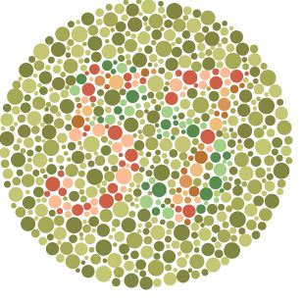
Color Blindness
Also known as color deficiency
Can happen when one or more of the color cone cells are absent, not working, or detect a different color than normal
usually have problems detecting greens and reds, and occasionally blues
Mild color deficiencies can see colors normally in good light but have difficulty in dim light
Severe color deficiencies cannot distinguish certain colors in any light.
Most severe type is when everything is seen in shades of gray (uncommon).
Color blindness usually affects both eyes equally and remains stable throughout life.
Color blindness is usually occur from birth but can also happen later in life
[6]
Notes:
There are different degrees of color blindness

Slide 6
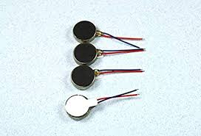
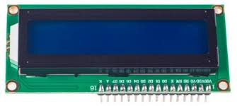
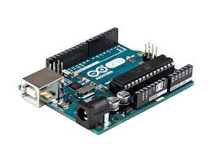
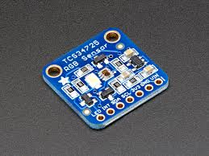
Objective
Help the visually impaired detect colors of the surrounding objects
Components:
RGB Sensor (TCS34725)
Motor
Arduino Uno
LCD display

Slide 7
TCS34725
Integrated IR blocking filter
Four independent analog-to-digital converters
Clear, red, green and blue
Enables accurate color and ambient light sensing under varying lighting conditions
Minimizes motion/transient errors
Temperature range: -40 to 85 C
Voltage: 3.3 to 5 V
[3]

Slide 8
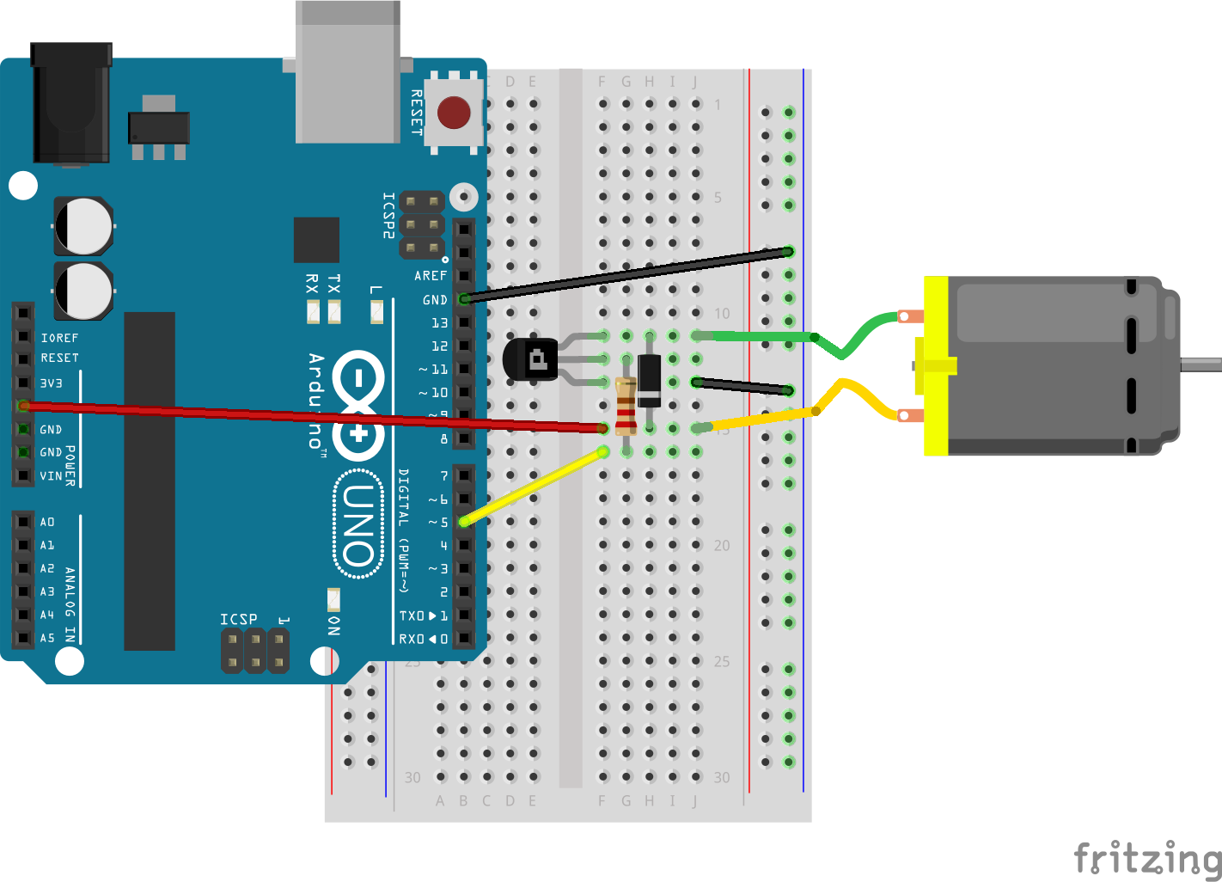
Arduino → Motor
[4]

Slide 9
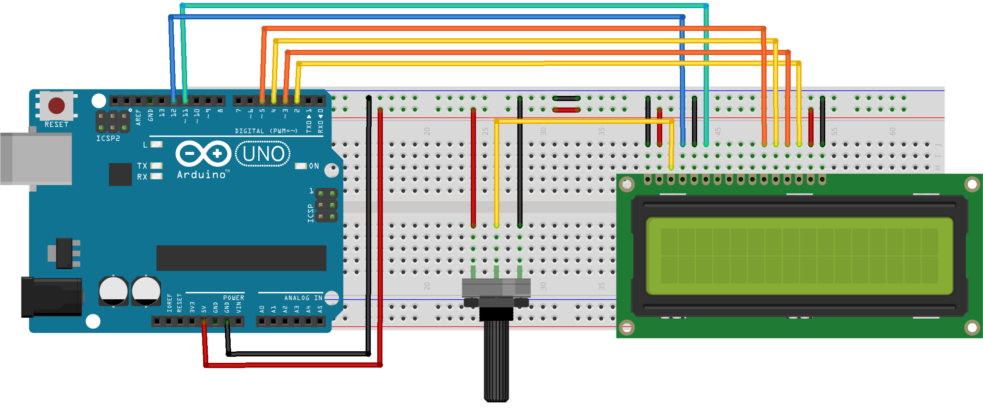
Arduino → LCD
[5]

Slide 10
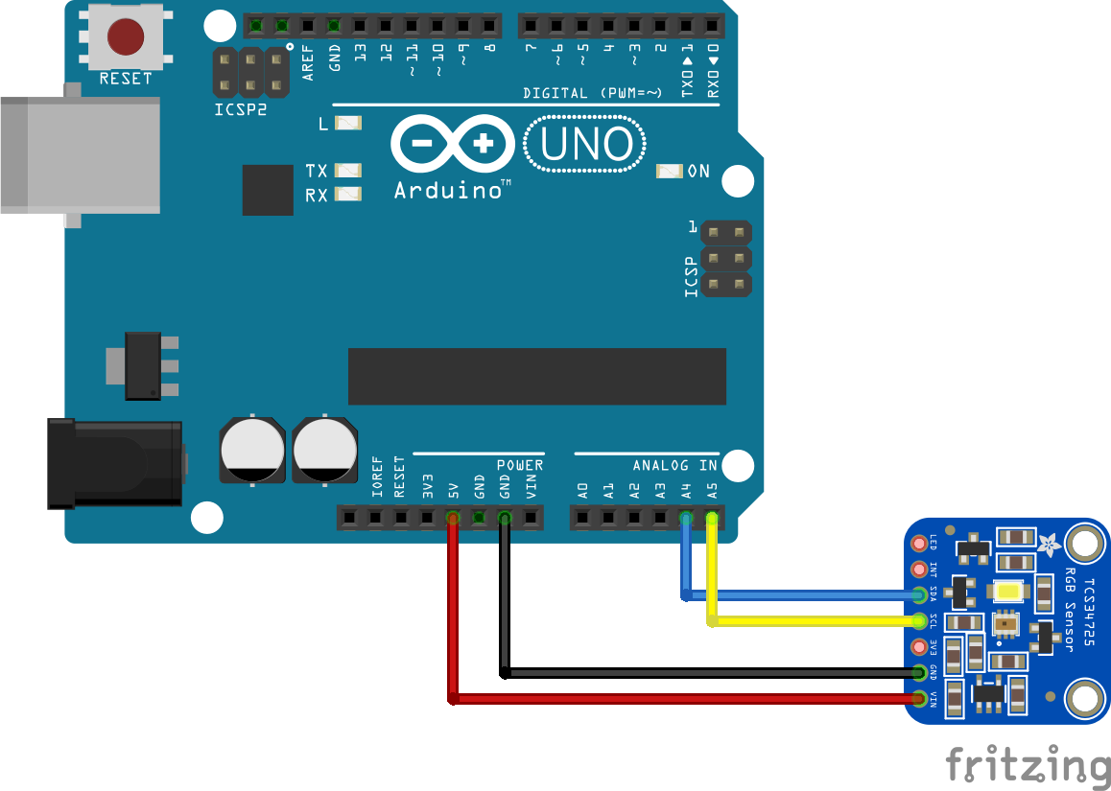
Arduino → TCS34725
[2]

Slide 11


Code

Slide 12
Limitations Improvements
Weak vibration due to small motor
Sensor is slow in detecting the colors
Connection is sometimes unstable
Can only detect RGB colors
Small detection range
Use a bigger motor
Use a different sensor with a bigger range
Change it into a wearable device
With just haptic feedback in the form of vibration
To keep the final product small and easy to use

Slide 13
[1] “The Importance of Sight and Vision – Molly Blakely - MarvelOptics™.” MarvelOptics, 17 June 2019,
https://marveloptics.com/blog/scholarship-program/the-importance-of-sight-and-vision-molly-blakely/.
[2] “Arduino and TCS34725 Color Sensor.” Arduino Learning, 26 Nov. 2017,
http://arduinolearning.com/code/arduino-tcs34725-color-sensor.php.
[3] “Color Sensor – Color Light-To-Digital Converter – TCS34725 Ams.” Ams, https://ams.com/tcs34725.
[4] “JavaScript Robotics: Motor (Johnny-Five).” Johnny, http://johnny-five.io/examples/motor/.
[5] “Lcd Display in Real Time.” Arduino Project Hub,
https://create.arduino.cc/projecthub/YoussefSabaa/lcd-display-in-real-time-ea0b7b.Turbert, David.
[6]“What Is Color Blindness?” American Academy of Ophthalmology, 6 Sept. 2019,
https://www.aao.org/eye-health/diseases/what-is-color-blindness.
References

